Slide 1
Immunoprofiling 2023
Learn how we count antibodies and T-Cell receptors in blood and other sources

Slide 2
Using BIG data to understand Immune Receptor Biology
and Immune System Manipulations
Setting Things Up
Obtain/Access Data
Data Cleaning and Prep
Processing Data
Analyzing Data/Subsets
Presenting Data
Team
@Ashly Corona Rodriguez
@Mahriban Yalkapova
@Keith L.
@Oscar Camargo
@Andrew Givone
@Rashmi Naidu
@Miguel Angel Rizzo Ignacio
Mexico, Spain, USA

Slide 3
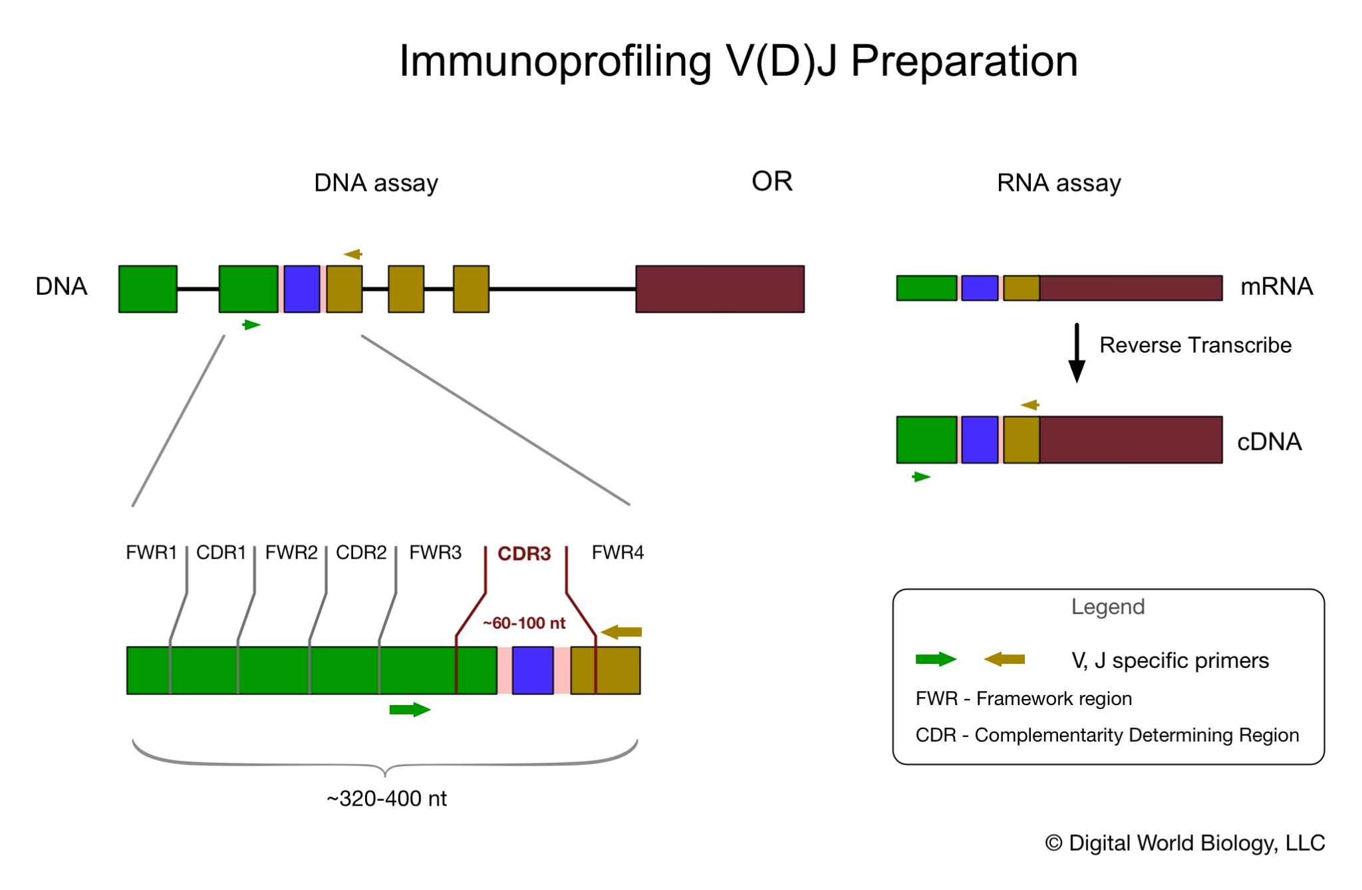
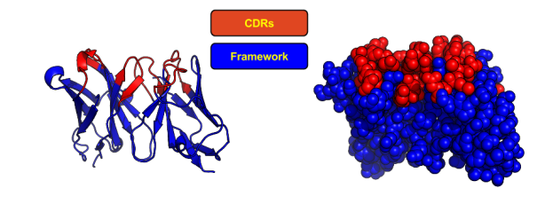
Basic Principal
Given a data set of 1+ million sequences what can we learn about global antibody diversity.
And the diversity of specific regions with in an antibody with respect to sequence structure and function.
FAb portion

Slide 4
Setting Things Up:
Assigned Roles - Writer - unanimous decision of Ashly!
Jetstream-2 and Jupyter Notebooks
Find and review data
Databases - iReceptor, EBI, NCBI, SabDab, IEDB (antibody - epitopes)
Merge data to obtain usable dataset for [Flu Vaccine, Breast/Lung Cancer]
Clean/remove non-useful entries

Slide 5
Current Progress - 2023AUG08
Writer
Data Source - Flu Vaccine
Sequences Aligned using IgBLASTn
Have table of annotated, 96 column VDJ Seq Data
Google table definitions of the 96 columns of data
Table of Data from iReceptor with Cancer Case and Control Dataset
Metadata file in JSON file format

Slide 6
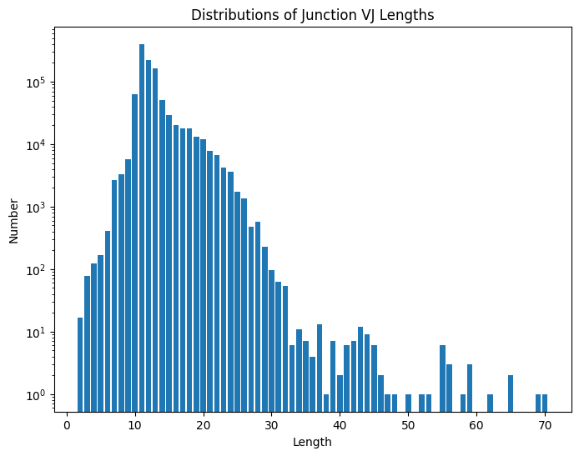
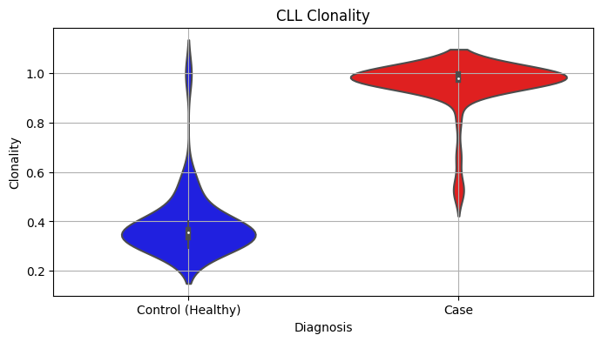
Future Tasks to Complete
DNA Sequence to Annotated Data
Trimming Sequence Data to improve quality (remove noise) of dataset
Investigate column contents from BLAST to filter noise
Create graphs and reports of BLAST table showing VDJ rearrangements and Ab biology
Using the Data for Comparative Analysis
Using Cancer Dataset, link TSV to Metadata (PANDAS)
Develop Jupyter Notebook based routines for comparative analysis
Infrastructure
Utilize GitHub to save and coordinate for future use

Slide 7
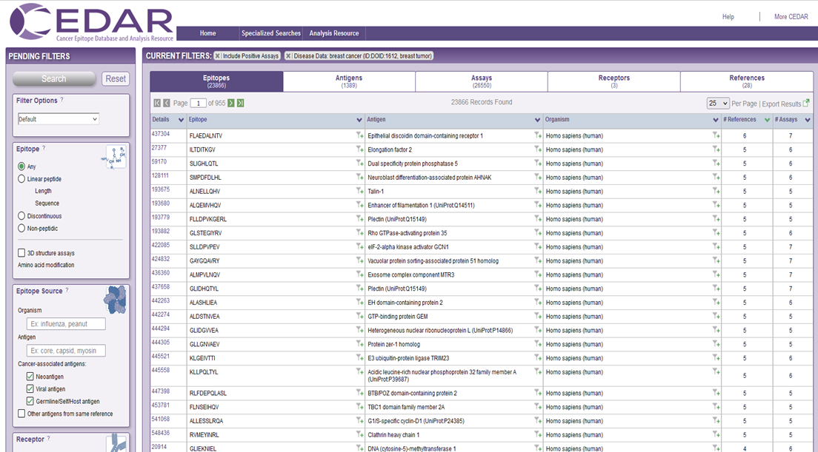
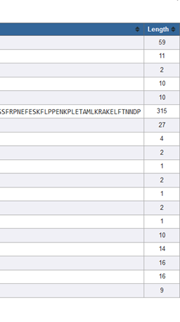
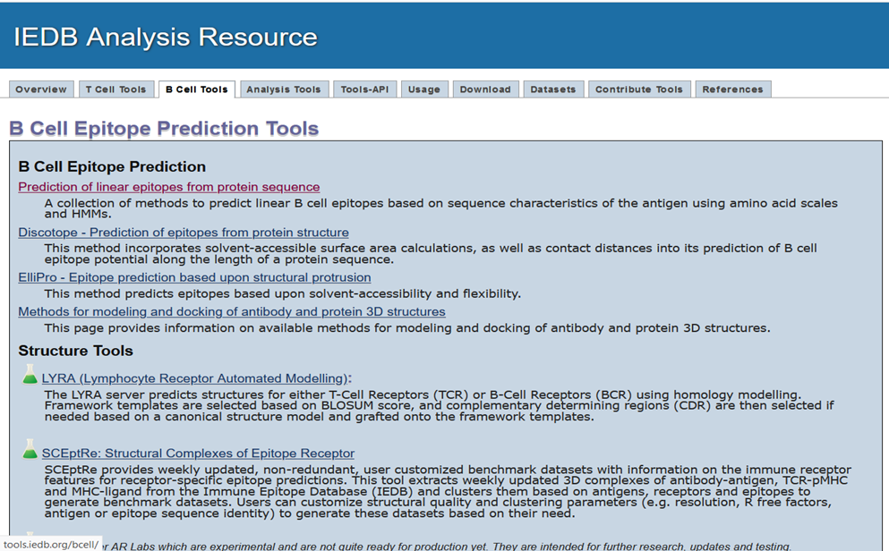
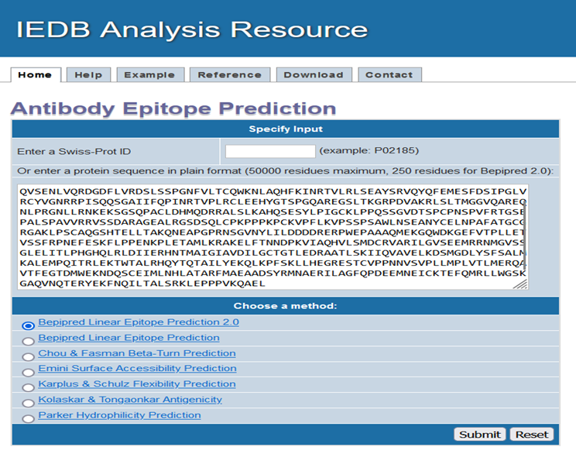
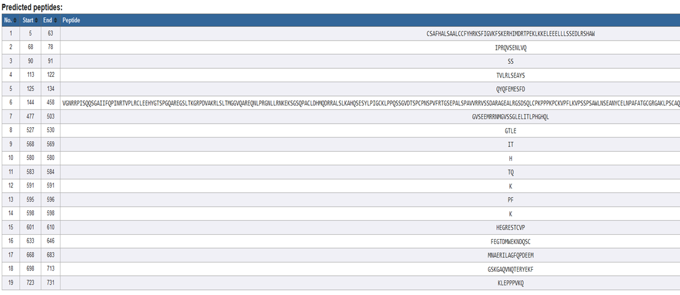
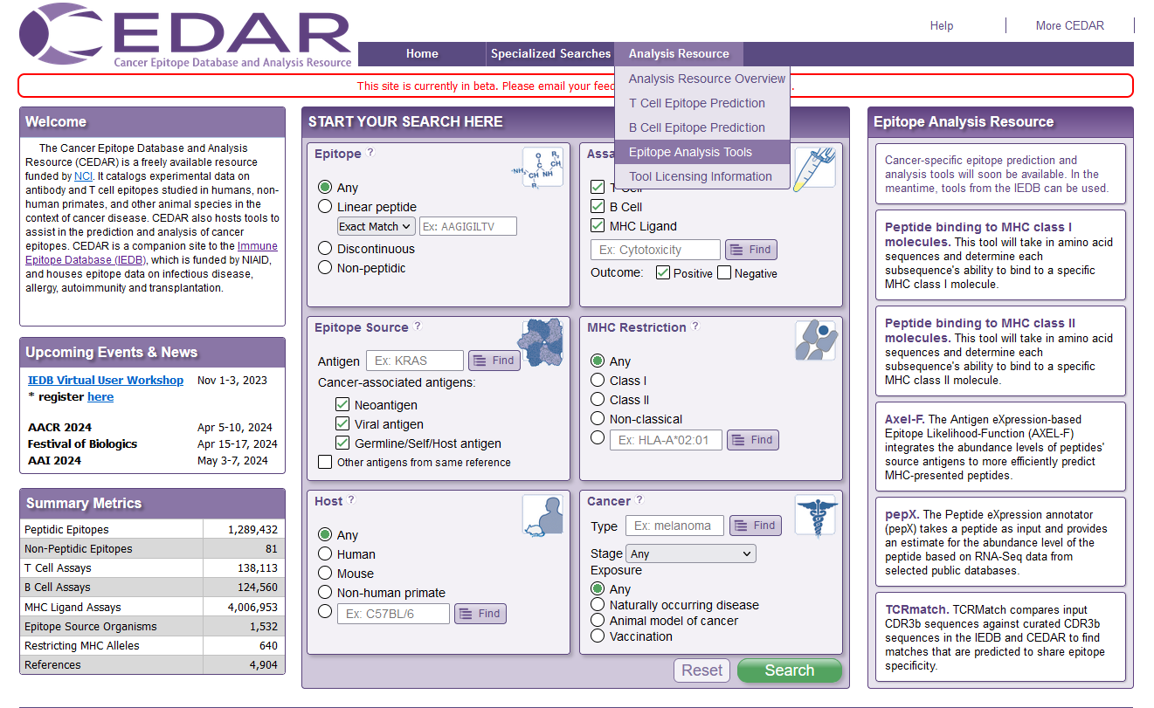
CEDAR

Slide 8
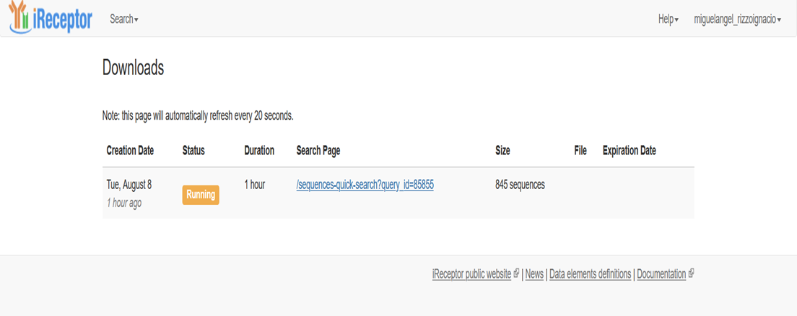
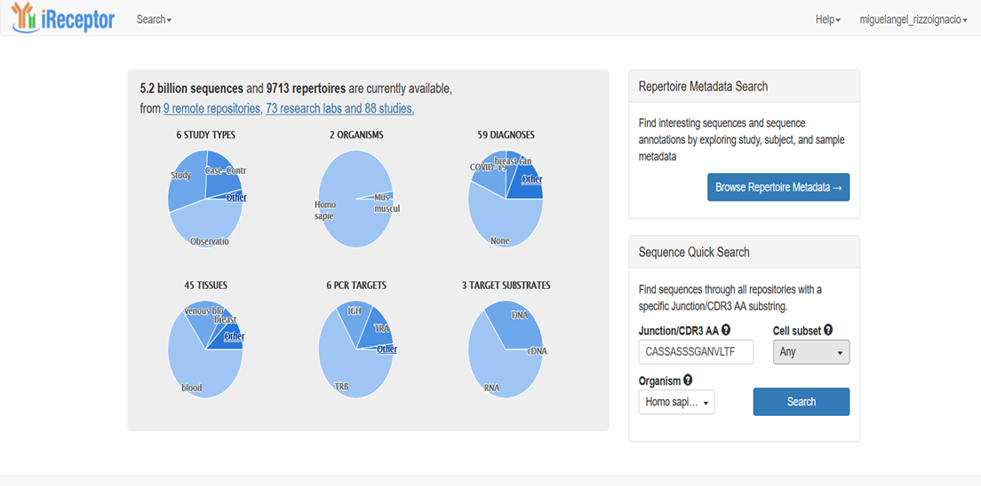
iReceptor

Slide 9
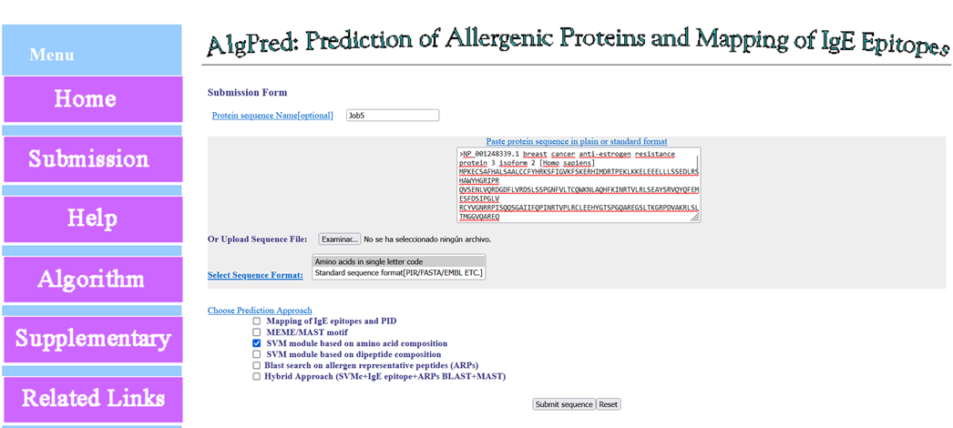
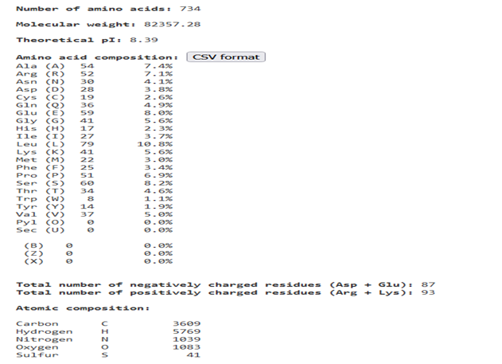
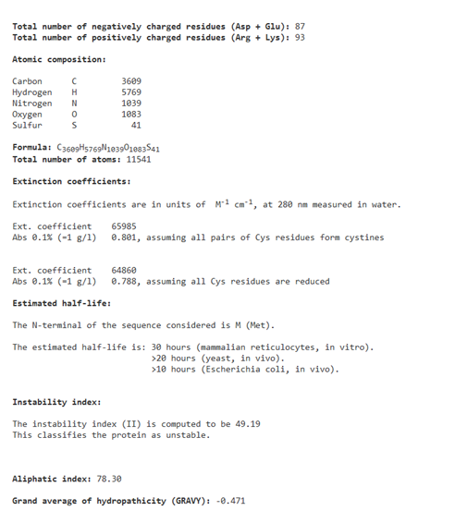
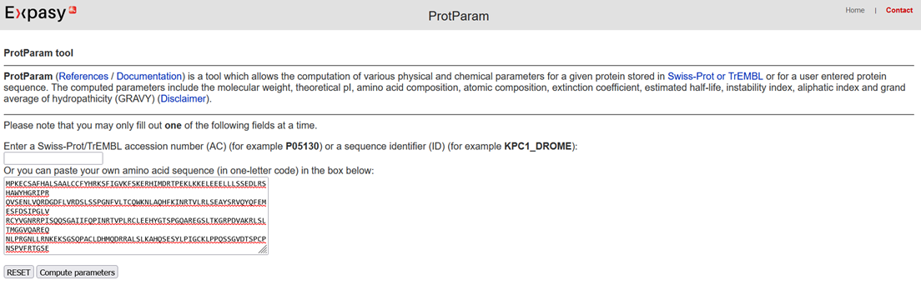
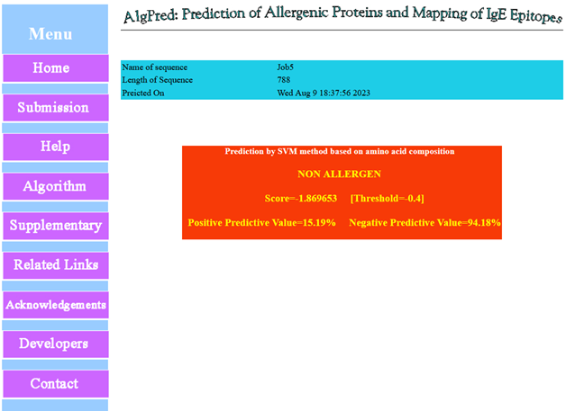
Other tools:
Allergenic protein. https://webs.iiitd.edu.in/raghava/algpred/submission.html
Stability?
https://web.expasy.org/protparam/

